Slide 1
Data Types Principles of Programming Language
S.Venkatesan
Reference: Robert W. Sebesta, Concepts of Programming Languages, 10th Edition, Pearson

Slide 2
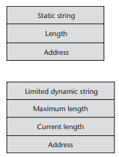
Data Types
Primitive Data Types
String
Should strings be a special kind of character array or a primitive type?
Should strings have static or dynamic length?
Arrays – Static, Fixed Stack-Dynamic, Fixed Heap-Dynamic, Heap-Dynamic.
Rectangular and Jagged Arrays
Strong Typing -> type errors are always detected.

Slide 3
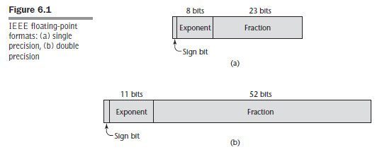
Floating Point

Slide 4
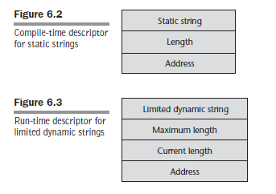
String

Slide 5
Solutions – Dynamic Length
Linked List
Array of Pointers to individual characters
Store in adjacent storage.
Move to other location on Demand

Slide 6
Pointer – Design Issues
What are the scope and lifetime of a pointer variable?
What is the lifetime of a heap- dynamic variable (the value a pointer references)?
Are pointers restricted as to the type of value to which they can point?
Are pointers used for dynamic storage management, indirect addressing, or both?
Should the language support pointer types, reference types, or both

Slide 7
Reference Type
A reference type variable is similar to a pointer, with one important and fundamental difference:
A pointer refers to an address in memory, while a reference refers to an object or a value in memory.
int result = 0;
int &ref_result = result;

Slide 8
Operations
Assignment
Dereferencing.
Dangling Pointers: A dangling pointer, or dangling reference, is a pointer that contains the address of a heap-dynamic variable that has been deallocated.
memory leakage

Slide 9
Expressions
An operator can be unary, meaning it has a single operand, binary, meaning it has two operands, or ternary, meaning it has three operands.
Operator Evaluation Order – Precedence, Associativity, Parenthesis
Operand Evaluation Order
Side effect: A side effect of a function, naturally called a functional side effect, occurs when the function changes either one of its parameters or a global variable.
a + fun(a)
int a = 5;
int fun1() {
a = 17;
return 3;
} /* end of fun1 */
void main() {
a = a + fun1();
} /* end of main */

Slide 10
Referential Transparency and Side Effects
A program has the property of referential transparency if any two expressions in the program that have the same value can be substituted for one another anywhere in the program, without affecting the action of the program.
result1 = (fun(a) + b) / (fun(a) - c);
temp = fun(a);
result2 = (temp + b) / (temp - c);
If the function fun has no side effects, result1 and result2 will be equal, because the expressions assigned to them are equivalent. However, suppose fun has the side effect of adding 1 to either b or c. Then result1 would not be equal to result2. So, that side effect violates the referential transparency of the program in which the code appears.

Slide 11
Enumeration Types
The design issues for enumeration types are as follows:
Is an enumeration constant allowed to appear in more than one type definition, and if so, how is the type of an occurrence of that constant in the program checked?
Are enumeration values coerced to integer?
Are any other types coerced to an enumeration type?

Slide 12
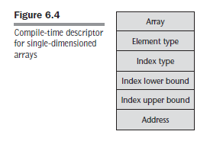
Array
Static Array
Fixed Stack - Dynamic Array
Fixed Heap – Dynamic Array
Heap Dynamic Array

Slide 13
Array Representation
Row major and column major order

Slide 14
Union Types
Store one value at a time that is recent but how C manages to get more.
Union Punning [Discriminant -> Type Checking or free -> freedom in using data type]

Slide 15
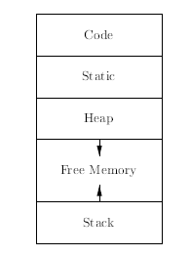
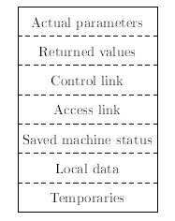
Runtime Memory

Slide 16
Referencing Environments
It is a collection of all variables that are visible in the statement.
The referencing environment of a statement in a static-scoped language is the variables declared in its local scope plus the collection of all variables of its ancestor scopes that are visible.

Slide 17
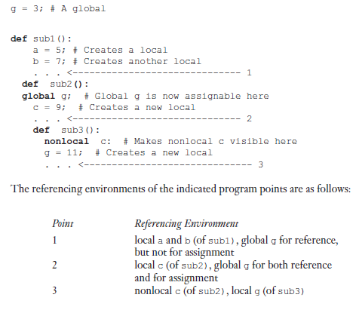
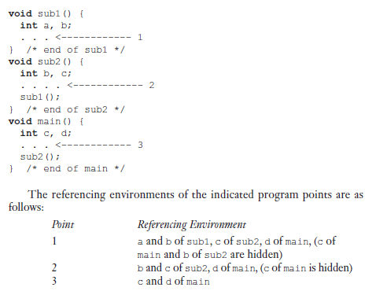
Python Example

Slide 18
Named Constants
It is a variable that is bound to a value only once.
It increases the readability and program reliability for example pi.
Another use of it is parameterize -> program usually uses the constant in a number of locations. Instead of that a name can be given so that it can be modified efficiently.
Ada and C++ allow dynamic binding of values to named constants.
C++ , const int result = 2 * width + 1
Java, final
C#, const and readonly
Static (before run time - initialization) and dynamic at run time.

Slide 19
Assignment Statements
Simple Assignments
Conditional Targets
Compound Assignment: sum += value;
Unary Assignment: sum = ++ count;
Assignment as an Expression
Multiple Assignments

Slide 20
Expression
Short Circuit Evaluation

Slide 21
Thanks

